Slide 1
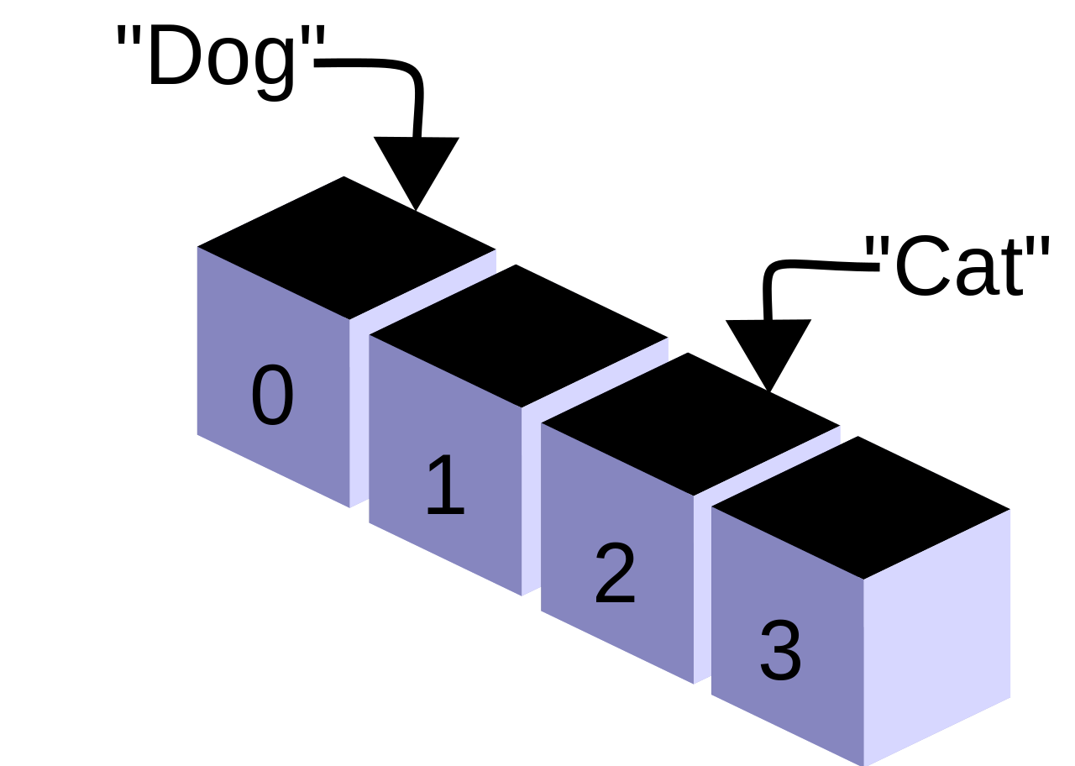
[...Knowledge]:
Arrays!

Slide 2
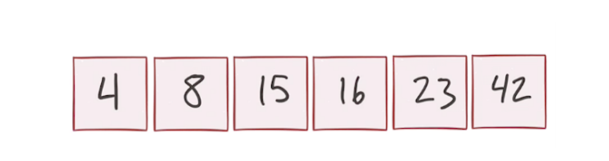
Arrays? Basic Concepts Bubble Sort Binary Search

Slide 3
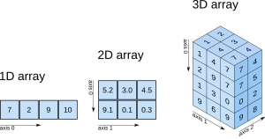
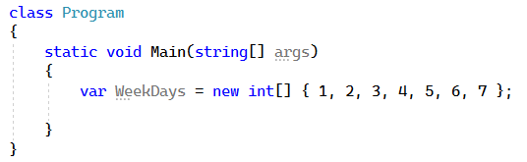
Arrays?
Simple
Stored in Contiguous Memory
Immutable (size, structure)
One or more dimensions
Very fast 0(1)

Slide 4
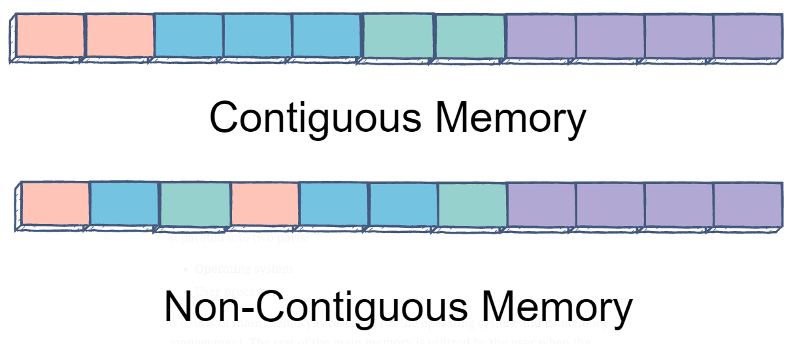

Slide 5

What should I use them for?
Good
Storing large amounts of data (known size + in one operation)
Searching data based on the key O(1)
Bad
Storing data for which we don’t know the quantity
Searching for data based on the value O(n)

Slide 6
Basic
Concepts

Slide 7

Bubble
Sort

Slide 8
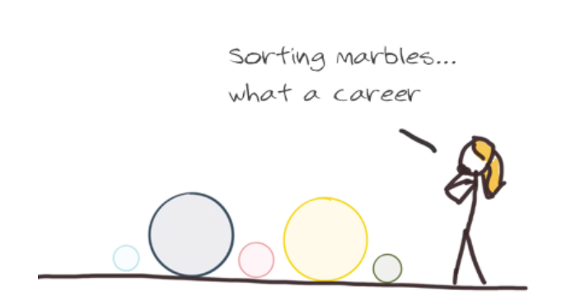
Bubble Sort?

Slide 9
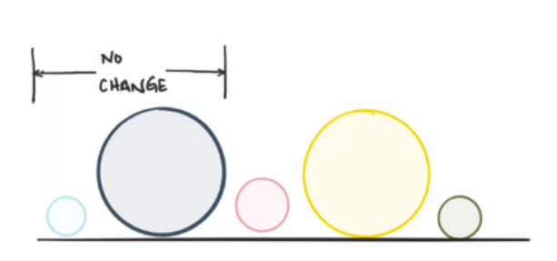
Bubble Sort?

Slide 10
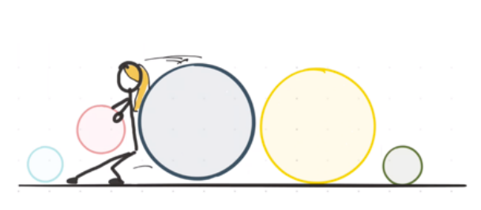
Bubble Sort?

Slide 11
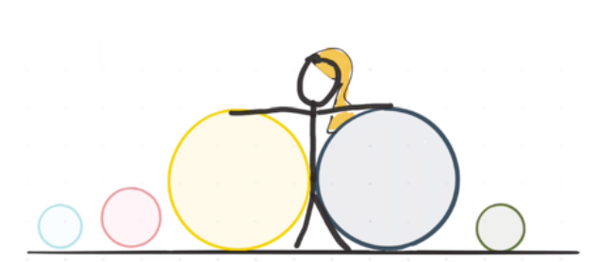
Bubble Sort?

Slide 12
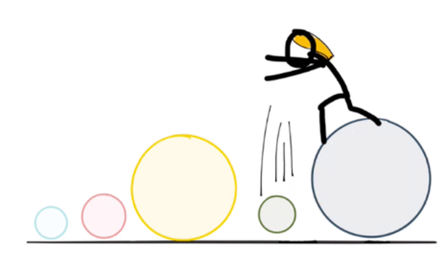
Bubble Sort?

Slide 13
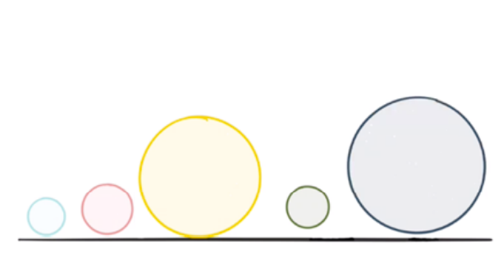
Bubble Sort?

Slide 14
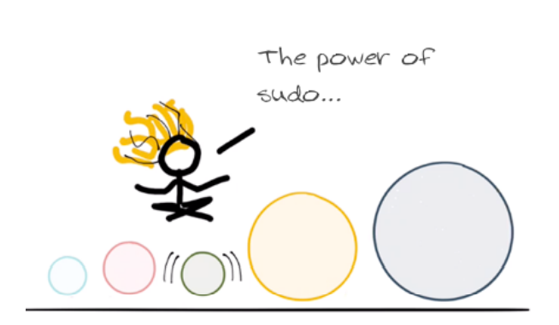
Bubble Sort?

Slide 15
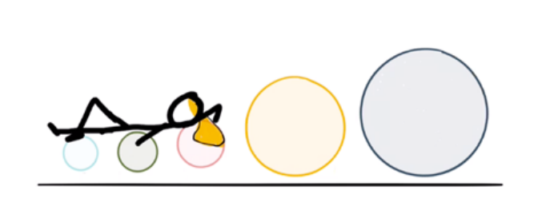
Bubble Sort?

Slide 16
Should we
try?

Slide 17
Binary
Search

Slide 18
Binary Search

Slide 19
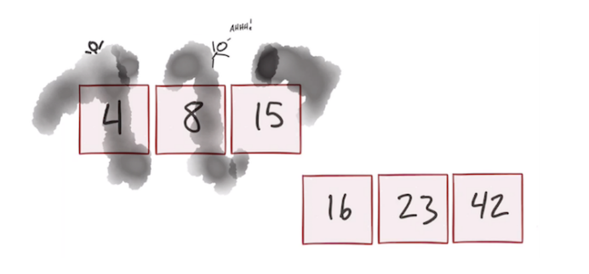
Binary Search

Slide 20
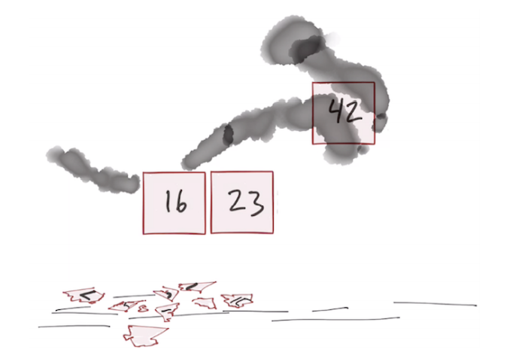
Binary Search

Slide 21
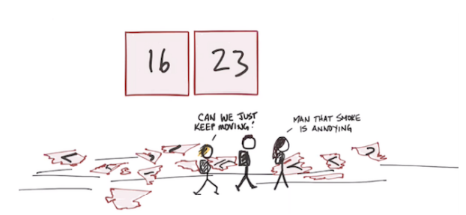
Binary Search

Slide 22
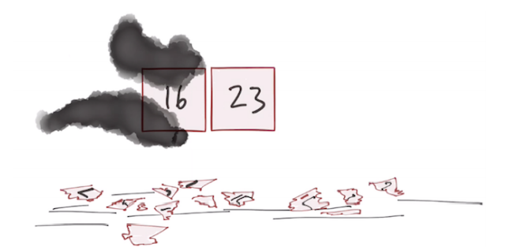
Binary Search

Slide 23
Should we
try?

Slide 24
Next time?
We’ll play battleship…

